Slide 1
Failed Banking Transaction Analysis
A comprehensive overview of data analysis for banking transactions
Chinchinada Sumasri

Slide 2
Introduction
This project focuses on analyzing failed banking transactions by building an end-to-end data processing pipeline using PySpark and Google Cloud Platform (GCP). Daily transaction data from multiple bank branches across different cities is collected in CSV format and stored in Google Cloud Storage. The data is then cleaned and combined using PySpark on a Dataproc cluster, and failed transactions are filtered and stored in a Cloud SQL (MySQL) database. The results are further analyzed and visualized using BigQuery to identify trends, patterns, and potential issues, enabling better decision-making and operational improvements.

Slide 3
Tools & Technologies
Google Cloud Storage (GCS)
Dataproc with PySpark
Cloud SQL (MySQL)
BigQuery for analytics
gsutil

Slide 4
1
Data Ingestion

Slide 5
Uploading CSV files to cloud bucket
The process begins with the upload of daily transaction data from CSV files provided by bank branches located in different cities. Each file contains transaction data encompassing multiple branches. The uploaded files will be stored in a cloud bucket, facilitating easy access and management.

Slide 6

Using gsutil for file management
Gsutil, a command-line tool, will be employed to manage the uploaded files efficiently. It allows for the upload the files in Google Cloud Storage. By utilizing gsutil, we ensure that all transaction data is securely stored and easily retrievable for further processing.

Slide 7
2
Data Processing

Slide 8
PySpark Job: Cleaning & Merging
A PySpark job is executed on a Dataproc single-node cluster for scalable and distributed processing.
The job reads multiple CSV files uploaded to Google Cloud Storage, each containing transaction data from different bank branches.
It performs data cleaning by:Removing rows with null values in critical fields like transaction_id, amount, or status.Eliminating blank records to ensure data quality.
After cleaning, the job combines all valid rows from the 15 input files into a single unified CSV file.
The final cleaned file is stored back in Google Cloud Storage (GCS) and serves as the foundation for the next stages of processing.

Slide 9
PySpark Job: Failed Transactions Filtering
The PySpark job reads the cleaned, consolidated CSV file generated from the previous data cleaning step.
It filters transaction records where the status is marked as 'FAILED', indicating unsuccessful banking transactions.
This process isolates only the relevant subset of data needed for operational analysis, significantly reducing volume and improving focus.
The filtered records are transformed and structured appropriately to match the schema of the target database table.
The resulting dataset is now ready for insertion into a Cloud SQL (MySQL) instance using JDBC connectors, enabling downstream querying and analysis.

Slide 10
Cloud SQL Integration
The filtered records of failed transactions are stored in a MySQL database hosted on Cloud SQL.
This integration ensures:
Reliable and structured data storage
Consistent schema for downstream analysis
Scalable solution for growing transaction volumes
The Cloud SQL table becomes a central data source for business reporting and visualization in BigQuery.

Slide 11
Visualization Using BigQuery
BigQuery is used as the analytics and reporting engine for the project.
It connects to the Cloud SQL (MySQL) database using federated queries, allowing direct querying without duplicating the data.
These SQL-based queries enable:
Generation of dynamic reports and dashboards
Identification of failure patterns by branch, region, and failure type
Tracking of daily or weekly trends in failed transactions
These visualizations can be embedded into Looker Studio (formerly Data Studio) or used in custom BI tools for executive reporting.

Slide 12
3
Visualizing Results

Slide 13
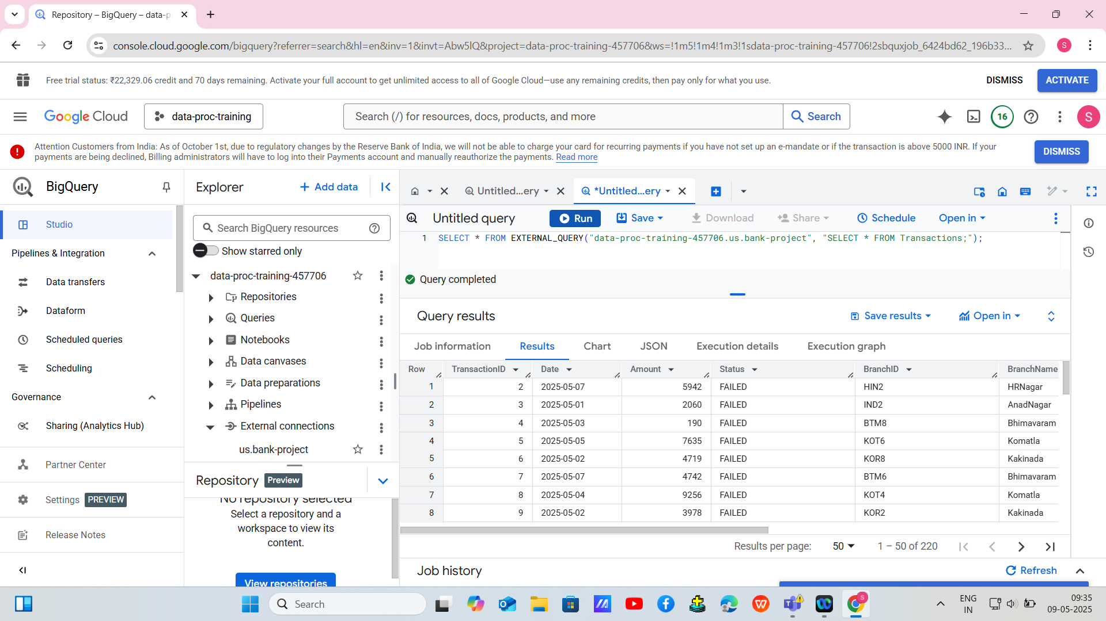

Slide 14
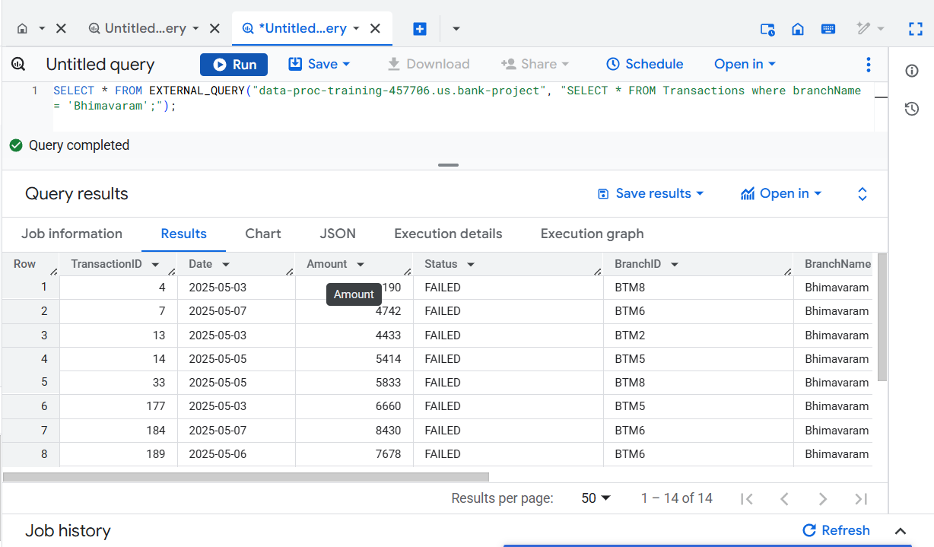
Query - 1
Select * from Transactions where branchName = ‘Bhimavaram’;

Slide 15
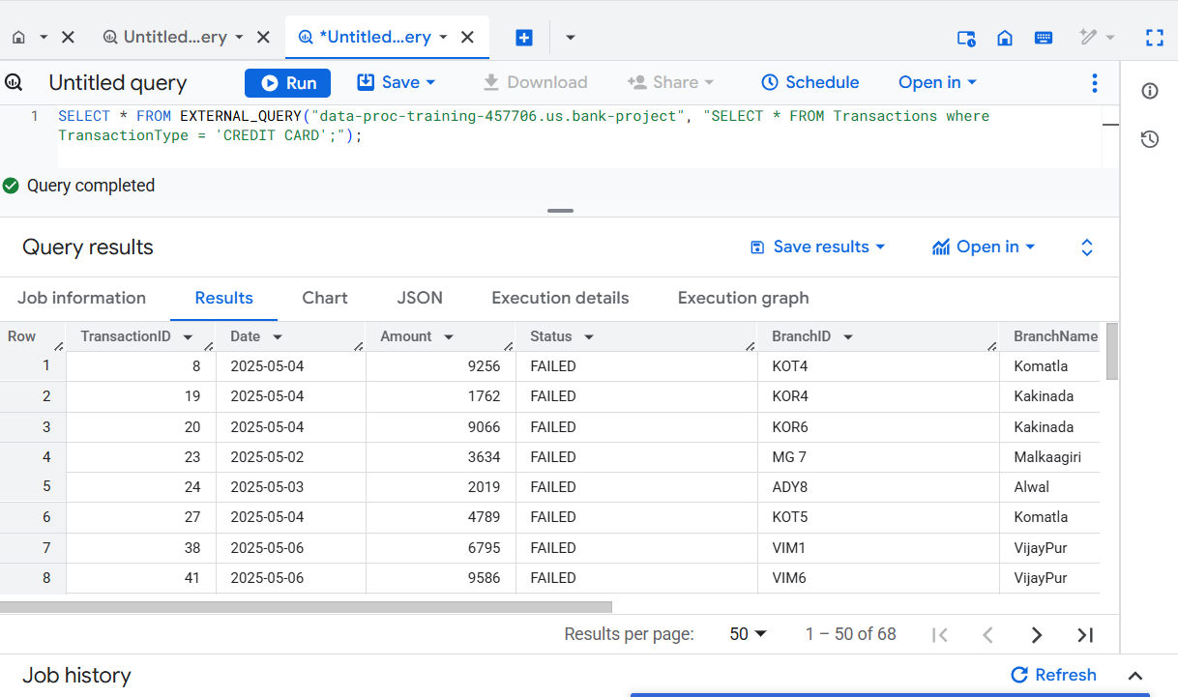
Query - 2
select * from Transactions where TransactionType = ‘CREDIT CARD’;

Slide 16
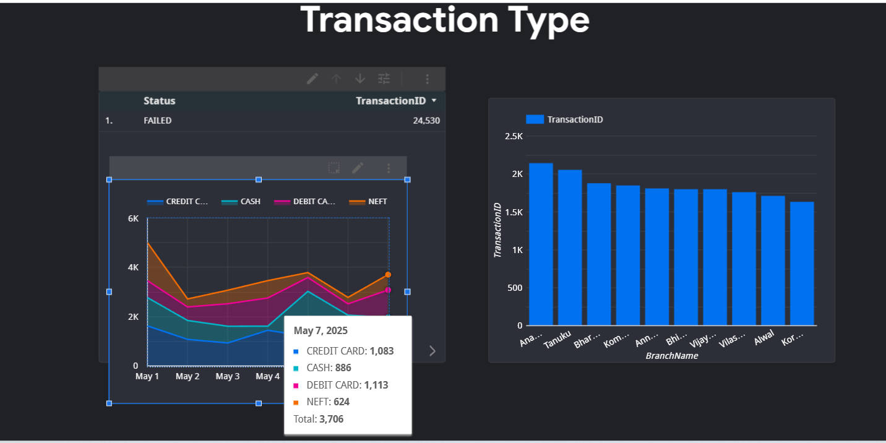
Result In Locker Studio

Slide 17
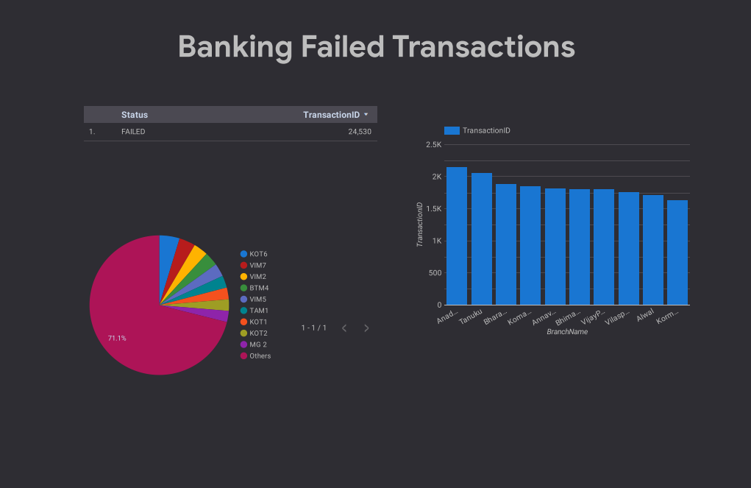

Slide 18
Conclusions
The integration and processing of transaction data from multiple bank branches are crucial for deriving actionable insights. By leveraging tools like gsutil, Dataproc, and PySpark, we can effectively manage and analyze transaction data, particularly focusing on failed transactions. This analysis will support informed decision-making and enhance operational efficiencies in banking transactions.

Slide 19
Thank You

